Slide 1
2023-2024 St. George State of the School
Thank you all for choosing St. George.
OUR DREAM TEAM: Parents, Staff, Students and Benefactors
Meet your School Commission

Slide 2
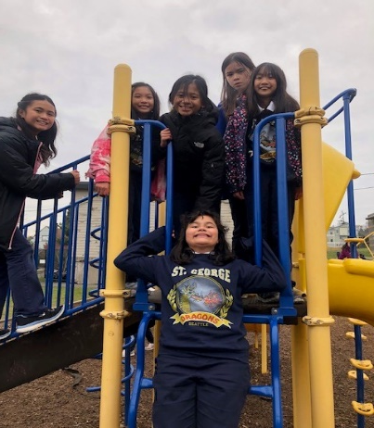
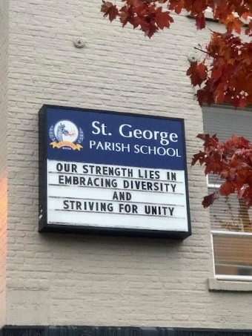
The foundational ethos that drive our decision-making
Mission
The community of St. George Parish School forms missionary disciples who continue the work of Jesus Christ as leaders in faith, service, and academics
Vision
To live like Jesus Christ in an ever changing world
Core Values:
Faith – Jesus is the center of who we are. We inspire all to develop a personal relationship with Jesus Christ and to spread that love to our community.
Social Justice – Service is the way we express God’s love. We are called to act with justice, be merciful, and walk humbly with Jesus. We love one another like Jesus loves us.
Diversity – Our diversity enriches our perspectives and strengthens our community. We are made to be different and designed to be one.
Collaboration – Our children’s success lies in the partnership of faculty, families, students and community. We are stronger when we work together.
Growth mindset – Everyone is a learner. Life-long learning is developed through curiosity, reflection, perseverance and self-advocacy.
Equity – Students are given the tools they need to succeed.
Notes:
Father Scott

Slide 3
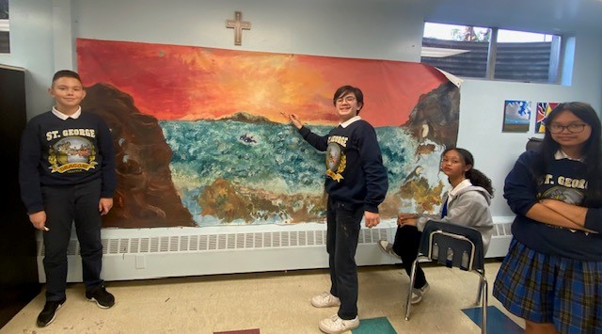
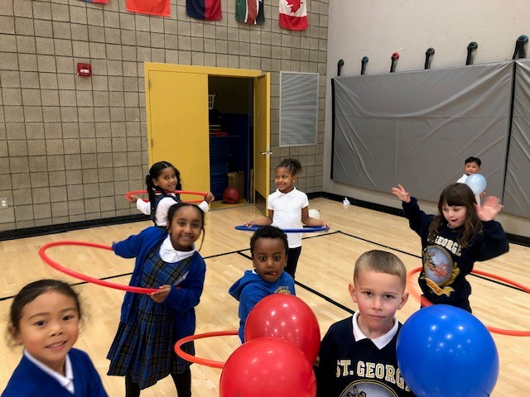
What makes St. George special?
It’s in our secret sauce!
This is OUR home: we are all responsible for its care.
Students/staff
School Commission
Parent Club Leaders
Parent involvement
Reputation:
Strong academics
Warm family like environment
Engaged students
Well-prepared for the challenges of high school
Notes:
Monica

Slide 4
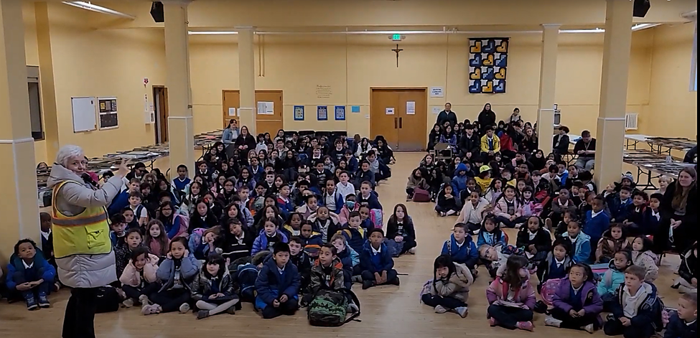
Parents' Club
Mission: Offer families a variety of ways to build community by fulfilling their fundraising and service hour commitments​
Looking Back
Thank you, Room Parents!
Community Building and Fundraising Highlights!
Uniform Sale
Jog-a-thon
Halloween Carnival
Grandparents Luncheon
Advent Gifts for PrePs Families
Weekly St. Vincent de Paul Collections
Looking Ahead
Feb 23 Lenten Soup Supper
March 9 Auction!
April 27 Annual Day of Service
April 28 Cultural Celebration
May 17 Career Day
Sunday, April 7th– Thursday, April 11th – Spirit Week at Tutta Bella (Columbia City)
Notes:
Mary Suni and Mia and Jennifer Ibach on Day of Service

Slide 5
Development & Alumni Association
Vision: Build funding strategies and relationships that contribute to a financially healthy and stable school-business with longevity of success | Mission: Connect and communicate with the community, cultivate and nurture relationships, share the value of St. George and the impact of involvement & donations | Values: Connection Communication Community
MAIN GOAL: bridge the tuition gap
Current Focus:
Annual Fund (goal is 100% participation from school families by 6/30/24)
Fundraising (Jog-a-thon, Auction, Dine Outs, etc.)
Donor, Stakeholder & Alumni relations (including implementing new CRM)
Other forms of giving (ie. employer matching, estate planning)
Balancing business needs with community needs (ie. marketing committee, feedback surveys, parent portal, in-house business directory, volunteer opps)
Fiscal Year: July 1st – June 30th
_________________
Alumni Association - keeps us connected to our roots and celebrates life ahead
Committee – fulfills service hours, including St. Edward & St. Paul alumni
Legacy program, Alumni outreach, Newsletter, Social Media, Events/Reunions
Upcoming Events – May 4th and October (TBD)
Notes:
Jessica

Slide 6
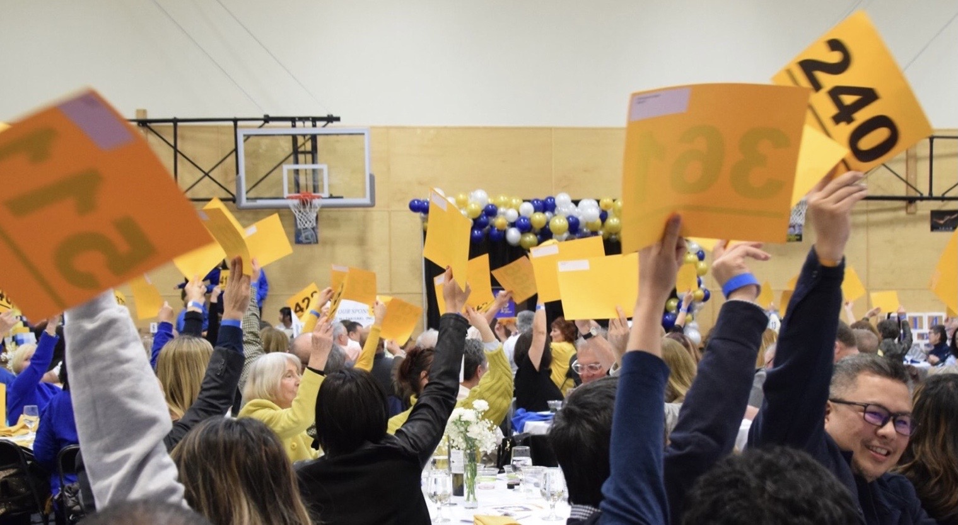
2024 St. George School Auction
24 KARAT MAGIC Saturday, March 9th 2024
Notes:
Hera & Clara

Slide 7
What expenses do we consider when building the budget
Competitive salaries and benefits for all staff
Support Programs: Extra staffing/specialists to support the changing needs of our students
Technology: device replacements-Chromebooks, computers; platform fees: iReady, Achieve 3000, Finalsite, Powerschool
Instructional resources needed: books, paper, PE equipment, art supplies, library books, science supplies-
Facilities: normal maintenance, deferred maintainance, equipment, yard, cleaning supplies This year $55K on plumbing alone
Tuition Assistance requests
Extended Care staff needs
We are working to create a 3-5 Year budget projection based on school trends/need.
Notes:
Sophia

Slide 8
What income do we consider when building the budget
Enrollment - affects cost to educate
Tuition price: In-Parish vs Out of Parish
Parish Subsidies. COMES FROM YOUR TITHING!
We look at the number of families claiming in-parish status and how that relates to mass participation, volunteerism in the parish and tithing collected to cover the cost to educate gap.
Tuition Assistance from endowment funds
Parent Fundraising/participation. This is YOUR PARTNERSHIP.
Grants
Fulcrum Foundation, City of Seattle Donations
New this year-Annual Fund
Net Numbers | Jogathon | Auction
2023-2024 | $54,438
2022-2023 | $52,255 | $139,355
2021-2022 | $65,764 | $107,878
2020-2021 | $49,193 | 0
2019-2020 ZOOM | $29,302 | $119,379
2018-2019 | $32,949 | $75,719
2017-2018 | $28,547 | $79,791
Notes:
Jordan

Slide 9
Notes
Preschool 30 full time & 10 half days
Cost to educate 24-25 $10,957/student (279 students)
Teachers 6% increase (83% of SPS)
More money is needed for maintenance
The goal is for tuition to cover the cost of salaries and benefits.
Notes:
Jordan

Slide 10
TUITION SCHEDULE
2024-2025
FAMILY SIZE
ANNUAL
MONTHLY (11)
Difference 23-24
Starting in
July
PARISHIONERS
1
$7,436
$676
$530
2
$14,498
$1,318
3
$21,747
$1,977
NON-PARISHIONERS
1
$9,196
$836
$346
2
$17,930
$1,630
3
$27,895
$2,445
COST TO EDUCATE one child is $10,957
-K-8 11 monthly payments (July-May) or one annual payment (August)
-Preschool & PreK 10 monthly payments (September-June) or one annual payment (August)

Slide 11
2023-2024 Tuition rates
Many schools are reducing the discount for siblings and in/out of parish. Some schools are charging solely the cost to educate (CTE). Other principals state a 4-10% increase of the price listed below in black for next year.
2023-2024 Tuition rates | In-Parish | Out of Parish
Holy Family Bilingual | $6,358 | $10,144
St. George- CTE $10,957 | 23/24 $6,950 24/25 7,436 | $8,850 9,196
St. Bernadette | $7,448 | $9,614
St. Francis | $8,181 | $11,185
St. Anthony | $8,417 | $12,386
St. Therese | $8,449 | $10,404
Holy Rosary | $9,500 | $11,910
Our Lady of Guadalupe | $9,655 | $11,650
St. Joseph | $18,460 (K-4) $19,185 (5-8) | $18,460 (K-4) $19,185 (5-8)
HNA: $22,368, PREP: $25,900, O’Dea: $19,555, Kennedy: $19,392
Notes:
Philip

Slide 12
REGISTRATION PROCESS Friday 2/09/24
Registration fee is $325/student and is due by March 1 to secure your child's spot
After March 1st, it’s $375, and registration will open to new students
Complete forms and pay online through Finalsite Credit card or electronic withdrawal only
Three mandatory commitments for each family (K-8)
Fundraising of $500. To fulfill the Fundraising Commitment, you may donate cash and/or participate in the following events:
Jogathon – September (100% credit)
Auction - March ($250 maximum credit for procured items)
30 Service Hours
May 1, 2024 - April 30, 2025. $30.00/hour not served.
A donation to the St. George Annual Fund for the 24-25 school year. Due between July 2024 and November 2024. Consider bridging the gap. We currently have ONE FAMILY who pays the cost to educate!
Notes:
Jennifer Ebreo

Slide 13
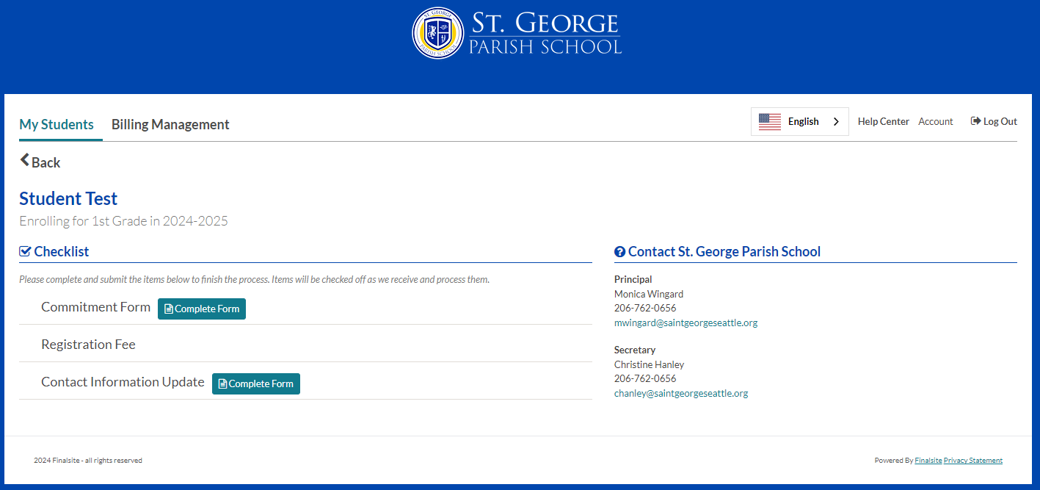
REGISTRATION PROCESS ON FINALSITE
In April, you will receive an email when the contract and the rest of the enrollment checklist are ready.
If you have not completed the 22-23 checklist or have any outstanding tuition balances due, you will not have access to the checklist.
Notes:
Jennifer Ebreo

Slide 14
Looking ahead…
SUMMER SCHOOL, Monday June 24 - Friday July 26th 2024
Preschool through Grade 5 (6-7 St. George only)
Registration coming in April
St. George Swag coming this summer!
Thank you for all the ways you help build St. George Parish School into a welcoming and loving community for all of us!
It is YOU who make St. George!
Notes:
Monica

